Slide 1



Software Development and Professional Practices
Requirements Engineering

Slide 2
Objectives
Understand the concepts of user and system requirements and why these requirements should be written in different ways.
Understand the differences between functional and non-functional software requirements.
Understand the main requirements engineering activities of elicitation, analysis, and validation, and the relationships between these activities;

Slide 3
Motivation
Telecom Egypt company’s manager asked you to develop a customer service system.
How to start?
What should you do?
Who will benefit from the system?
What the system is supposed to do? . . . .

Slide 4
Motivation
Problem
Solution

Slide 5
Motivation
Problem
Solution
Understand the problem
Design the solution

Slide 6
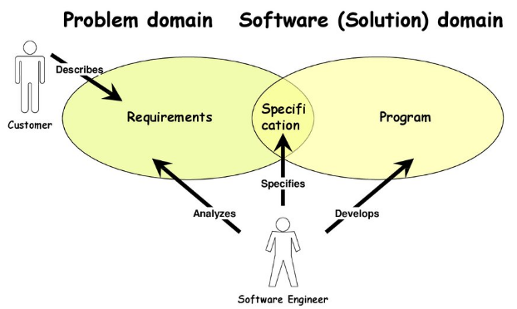
Motivation
To understand a problem, you need to determine the system’s input and output and define the system requirements.

Slide 7
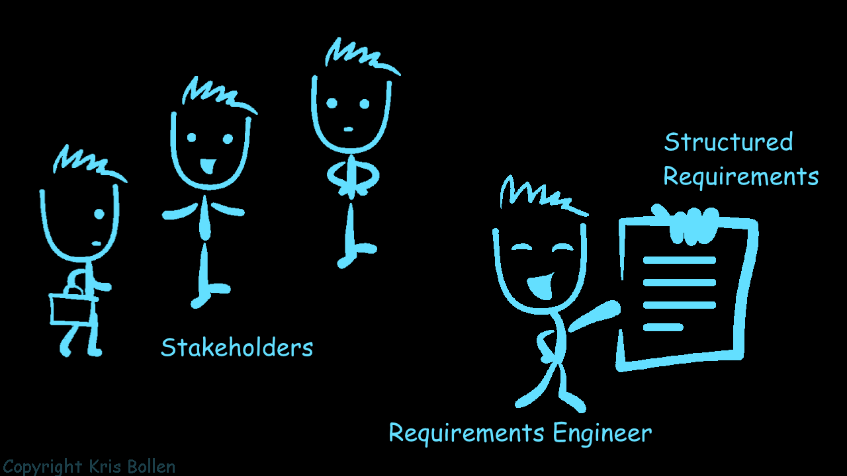
Introduction
The requirements for a system are the descriptions of the services that a system should provide and the constraints on its operation.
These requirements reflect the needs of customers for a system that serves a certain purpose
controlling a device
placing an order
finding information.

Slide 8
Introduction
The process of finding out, analysing, documenting and checking these services and constraints is called requirements engineering (RE).
Requirements engineering is usually presented as the first stage of the software engineering process.

Slide 9
Introduction
Two levels of requirements
User requirements to mean the high-level abstract requirements
System requirements to mean the detailed description of what the system should do.
System requirements specification
On the last working day of each month, a summary of the drugs prescribed, their cost and the prescribing clinics shall be generated.
The system shall generate the report for printing after 17.30 on the last working day of the month.
A report shall be created for each clinic and shall list the individual drug names, the total number of prescriptions, the number of doses prescribed and the total cost of the prescribed drugs.
If drugs are available in different dose units (e.g. 10mg, 20mg, etc.) separate reports shall be created for each dose unit.
Access to drug cost reports shall be restricted to authorized users as listed on a management access control list.
User requirements definition
The Mentcare system shall generate monthly management reports showing the cost of drugs prescribed by each clinic during that month.

Slide 10
Introduction
Readers of different types of requirements specification
Client managers
System end-users
Client engineers
Contractor managers
System architects
User
requirements
System end-users
Client engineers
System architects
Software developers
System
requirements

Slide 11
Introduction
System stakeholders for the Mentcare system include:
Patients whose information is recorded in the system and relatives of these patients.
Doctors who are responsible for assessing and treating patients.
Nurses who coordinate the consultations with doctors and administer some treatments.
Receptionists who manage patients’ appointments.
IT staff who are responsible for installing and maintaining the system.

Slide 12
Content
Functional and non-functional requirements
Requirements engineering processes
Requirements elicitation
Requirements specification
Requirements validation
Requirements change

Slide 13
Functional or Non-functional Requirements
Software system requirements are often classified as functional or non-functional requirements:
Functional requirements
Non-functional requirements
services the system should provide
how the system should react to particular inputs
how the system should behave in particular situations
constraints on the services or functions offered by the system.
timing constraints
constraints on the development process
constraints imposed by standards
may also explicitly state what the system should not do.
often apply to the system as a whole rather than individual system features
or services.

Slide 14
Functional or Non-functional Requirements
Generate reports each day
A user shall be able to search the appointments lists for all clinics.
Each staff member using the system shall be uniquely identified by his or her eight-digit employee number.
Functional requirements
Non-functional requirements
services the system should provide
how the system should react to particular inputs
how the system should behave in particular situations
constraints on the services or functions offered by the system.
timing constraints
constraints on the development process
constraints imposed by standards

Slide 15
Functional or Non-functional Requirements
What should the system do If:
the user entered wrong password and wrong username.
either username or the password is incorrect
the user entered non-English letter
For messenger app, if the sender sends a long voice message.
Functional requirements
Non-functional requirements
services the system should provide
how the system should react to particular inputs
how the system should behave in particular situations
constraints on the services or functions offered by the system.
timing constraints
constraints on the development process
constraints imposed by standards

Slide 16
Functional or Non-functional Requirements
What should the system do If:
For Messenger, the sender sent a message then deleted it before the receiver receives it?
For Messenger, the sender sent a message then deleted it before the receiver read it?
For Messenger, the sender sent a message then deleted it after the receiver read it?
A Facebook account is hacked?
Functional requirements
Non-functional requirements
services the system should provide
how the system should react to particular inputs
how the system should behave in particular situations
constraints on the services or functions offered by the system.
timing constraints
constraints on the development process
constraints imposed by standards

Slide 17
Functional or Non-functional Requirements
Number of target systems
Percentage of events causing failure
Number of concurrent users
The Mentcare system shall be available to all clinics during normal working hours
Users of the Mentcare system identify themselves using their health authority identity card.
Functional requirements
Non-functional requirements
services the system should provide
how the system should react to particular inputs
how the system should behave in particular situations
constraints on the services or functions offered by the system.
timing constraints
constraints on the development process
constraints imposed by standards

Slide 18
Functional or Non-functional Requirements
For banking systems, processed transactions/second
User/event response time
For games, screen refresh time
File hosting websites, download/upload time
Functional requirements
Non-functional requirements
services the system should provide
how the system should react to particular inputs
how the system should behave in particular situations
constraints on the services or functions offered by the system.
timing constraints
constraints on the development process
constraints imposed by standards

Slide 19
Functional or Non-functional Requirements
Programming language
Frameworks and libraries
Localization (languages)
Functional requirements
Non-functional requirements
services the system should provide
how the system should react to particular inputs
how the system should behave in particular situations
constraints on the services or functions offered by the system.
timing constraints
constraints on the development process
constraints imposed by standards

Slide 20
Functional or Non-functional Requirements
Privacy policy
Discount 10% taxes (Vodafone, We, …)
Functional requirements
Non-functional requirements
services the system should provide
how the system should react to particular inputs
how the system should behave in particular situations
constraints on the services or functions offered by the system.
timing constraints
constraints on the development process
constraints imposed by standards

Slide 21
Functional Requirements
Written in natural language so that system users and managers can understand them.
Expand the user requirements and are written for system developers.
Describe the system functions, their inputs and outputs, and exceptions in detail.
Stakeholders are likely to have different—and often inconsistent— needs.

Slide 22
Non-functional Requirements
Non-functional requirements are not concerned with the specific services delivered by the system to its users.
Non-functional requirements are often more critical than individual functional requirements.
System users can find a system function that doesn’t meet their needs. Failing to meet a non-functional requirement can mean that the whole system is unusable.
For example, if an aircraft system does not meet its reliability requirements, it will not be certified as safe for operation;
if an embedded control system fails to meet its performance requirements, the control functions will not operate correctly.

Slide 23
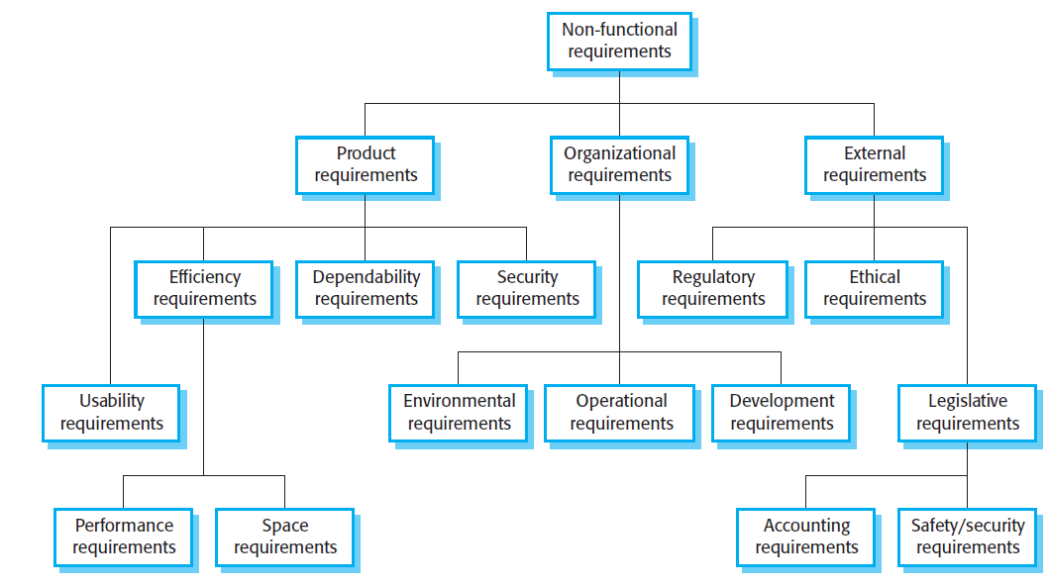
Non-functional Requirements
Types of non-functional requirements

Slide 24
Non-functional Requirements
Metrics for specifying non-functional requirements
Property | Measure
Speed | Processed transactions/second User/event response time Screen refresh time
Size | Megabytes/Number of ROM chips
Ease of use | Training time Number of help frames
Reliability | Mean time to failure Probability of unavailability Rate of failure occurrence Availability
Robustness | Time to restart after failure Percentage of events causing failure Probability of data corruption on failure
Portability | Percentage of target dependent statements Number of target systems

Slide 25
Functional and Non-functional Requirements
Requirements are not independent, and one requirement often generates or constrains other requirements.
A user requirement concerned with security, such as a statement limiting access to authorized users, may appear to be a non-functional requirement. However, when developed in more detail, this requirement may generate other requirements that are clearly functional, such as the need to include user authentication facilities in the system.

Slide 26
Exercise
Telcom Egypt company needs a system for customer services. The system is supposed to be used by technical and non-technical users. All users are Arabian users. The system allows the user to record the customer’s issues, determine a date so that a technician can visit the customer. The system also should provide maintenance tools allowing the user to check for connection problems between customer’s router and the server. The system allows the manager to create account for users, so that each user is identified on his work shift. The system must record the talk between the customer and the user to review the users’ performance. At the end of each day, the system generates a report gives statistics about the customer care service with users. At the end of each call, the system sends an evaluation enquiry about the service. The reports are delivered to the CEO via email.
Stakeholders? Functional requirements? Non-functional requirements?

Slide 27
Exercise
Telcom Egypt company needs a system for customer services. The system is supposed to be used by technical and non-technical users. All users are Arabian users. The system allows the user to record the customer’s issues, determine a date so that a technician can visit the customer. The system also should provide maintenance tools allowing the user to check for connection problems between customer’s router and the server. The system allows the manager to create account for users, so that each user is identified on his work shift. The system must record the talk between the customer and the user to review the users’ performance. At the end of each day, the system generates a report gives statistics about the customer care service with users. At the end of each call, the system sends an evaluation enquiry about the service. The reports are delivered to the CEO via email.
Stakeholders?

Slide 28
Exercise
Telcom Egypt company needs a system for customer services. The system is supposed to be used by technical and non-technical users. All users are Arabian users. The system allows the user to record the customer’s issues, determine a date so that a technician can visit the customer. The system also should provide maintenance tools allowing the user to check for connection problems between customer’s router and the server. The system allows the manager to create account for users, so that each user is identified on his work shift. The system must record the talk between the customer and the user to review the users’ performance. At the end of each day, the system generates a report gives statistics about the customer care service with users. At the end of each call, the system sends an evaluation enquiry about the service. The reports are delivered to the CEO via email.
Functional requirements?

Slide 29
Exercise
The system must be in Arabic
Simple, easy-to-use, non-professional UX
Reliable database to store dates
Telcom Egypt company needs a system for customer services. The system is supposed to be used by technical and non-technical users. All users are Arabian users. The system allows the user to record the customer’s issues, determine a date so that a technician can visit the customer. The system also should provide maintenance tools allowing the user to check for connection problems between customer’s router and the server. The system allows the manager to create account for users, so that each user is identified on his work shift. The system must record the talk between the customer and the user to review the users’ performance. At the end of each day, the system generates a report gives statistics about the customer care service with users. At the end of each call, the system sends an evaluation enquiry about the service. The reports are delivered to the CEO via email.
Reliability, Speed, Robustness
Non-functional requirements?

Slide 30
Exercise
Telcom Egypt company needs a system for customer services. The system is supposed to be used by technical and non-technical users. All users are Arabian users. The system allows the user to record the customer’s issues, determine a date so that a technician can visit the customer. The system also should provide maintenance tools allowing the user to check for connection problems between customer’s router and the server. The system allows the manager to create account for users, so that each user is identified on his work shift. The system must record the talk between the customer and the user to review the users’ performance. At the end of each day, the system generates a report gives statistics about the customer care service with users. At the end of each call, the system sends an evaluation enquiry about the service. The reports are delivered to the CEO via email.
Security, Authentication
Reliability, security,
Conciseness, Organized, easy to read
Integrity, responsive
Security
Non-functional requirements?

Slide 31
Exercise
This software system will be a Web Publishing System for a local editor of a regional historical society. This system will be designed to maximize the editor’s productivity by providing tools to assist in automating the article review and publishing process, which would otherwise have to be performed manually. By maximizing the editor’s work efficiency and production the system will meet the editor’s needs while remaining easy to understand and use. More specifically, this system is designed to allow an editor to manage and communicate with a group of reviewers and authors to publish articles to a public website. The software will facilitate communication between authors, reviewers, and the editor via E-Mail. Preformatted reply forms are used in every stage of the articles’ progress through the system to provide a uniform review process; the location of these forms is configurable via the application’s maintenance options. The system also contains a relational database containing a list of Authors, Reviewers, and Articles.
Stakeholders? Functional requirements? Non-functional requirements?

Slide 32
Exercise
This software system will be a Web Publishing System for a local editor of a regional historical society. This system will be designed to maximize the editor’s productivity by providing tools to assist in automating the article review and publishing process, which would otherwise have to be performed manually. By maximizing the editor’s work efficiency and production the system will meet the editor’s needs while remaining easy to understand and use. More specifically, this system is designed to allow an editor to manage and communicate with a group of reviewers and authors to publish articles to a public website. The software will facilitate communication between authors, reviewers, and the editor via E-Mail. Preformatted reply forms are used in every stage of the articles’ progress through the system to provide a uniform review process; the location of these forms is configurable via the application’s maintenance options. The system also contains a relational database containing a list of Authors, Reviewers, and Articles.
Stakeholders?

Slide 33
Exercise
This software system will be a Web Publishing System for a local editor of a regional historical society. This system will be designed to maximize the editor’s productivity by providing tools to assist in automating the article review and publishing process, which would otherwise have to be performed manually. By maximizing the editor’s work efficiency and production the system will meet the editor’s needs while remaining easy to understand and use. More specifically, this system is designed to allow an editor to manage and communicate with a group of reviewers and authors to publish articles to a public website. The software will facilitate communication between authors, reviewers, and the editor via E-Mail. Preformatted reply forms are used in every stage of the articles’ progress through the system to provide a uniform review process; the location of these forms is configurable via the application’s maintenance options. The system also contains a relational database containing a list of Authors, Reviewers, and Articles.
Functional requirements?

Slide 34
Exercise
Usability
This software system will be a Web Publishing System for a local editor of a regional historical society. This system will be designed to maximize the editor’s productivity by providing tools to assist in automating the article review and publishing process, which would otherwise have to be performed manually. By maximizing the editor’s work efficiency and production the system will meet the editor’s needs while remaining easy to understand and use. More specifically, this system is designed to allow an editor to manage and communicate with a group of reviewers and authors to publish articles to a public website. The software will facilitate communication between authors, reviewers, and the editor via E-Mail. Preformatted reply forms are used in every stage of the articles’ progress through the system to provide a uniform review process; the location of these forms is configurable via the application’s maintenance options. The system also contains a relational database containing a list of Authors, Reviewers, and Articles.
Usability
Reliability, Speed
Non-functional requirements?

Slide 35
Content
Functional and non-functional requirements
Requirements engineering processes
Requirements elicitation
Requirements specification
Requirements validation
Requirements change

Slide 36
Requirements Engineering Processes
Requirements engineering involves three key activities:
Elicitation and
Analysis
Discovering requirements by interacting with stakeholders
Specification
Converting these requirements into a standard form
Validation
checking that the requirements actually define the system that the customer wants

Slide 37
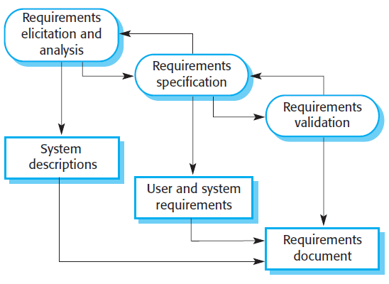
Requirements Engineering Processes
Requirements engineering is an iterative process in which the activities are interleaved.

Slide 38
Content
Functional and non-functional requirements
Requirements engineering processes
Requirements elicitation
Requirements specification
Requirements validation
Requirements change

Slide 39
Requirements Elicitation
Requirements elicitation aims to understand the work that stakeholders do and how they might use a new system to help support that work.
1. Requirements discovery and understanding
2. Requirements classification and organization
3. Requirements prioritization and negotiation
4. Requirements documentation

Slide 40
Requirements Elicitation
There are two fundamental approaches to requirements elicitation:
Interviewing
where you talk to people about what they do.
Observation or ethnography
where you watch people doing their job to see what artifacts they use, how they use them, and so on.

Slide 41
Content
Functional and non-functional requirements
Requirements engineering processes
Requirements elicitation
Requirements specification
Requirements validation
Requirements change

Slide 42
Requirements Specification
Requirements specification is the process of writing down the user and system requirements in a requirements document.
written in natural language supplemented by appropriate diagrams and tables in the requirements document.
The software requirements specification (SRS) is an official statement of what the system developers should implement.
Template: https://web.cs.dal.ca/~hawkey/3130/srs_template-ieee.doc
Example: https://gephi.org/users/gephi_srs_document.pdf
Refer to page 128 in the textbook (Software Engineering, Sommerville 10th edition), figure 4.17

Slide 43
Content
Functional and non-functional requirements
Requirements engineering processes
Requirements elicitation
Requirements specification
Requirements validation
Requirements change

Slide 44
Requirements validation
Requirements validation is the process of checking that requirements define the system that the customer really wants.
It overlaps with elicitation and analysis, as it is concerned with finding problems with the requirements.
The cost of fixing a requirements problem by making a system change is usually much greater than repairing design or coding errors.
A change to the requirements usually means that the system design and implementation must also be changed.
Furthermore, the system must then be retested.

Slide 45
Requirements validation
Validation techniques
Requirements reviews
Prototyping
Test-case generation
The requirements are analyzed systematically by a team of reviewers who check for errors and inconsistencies.
Developing an executable model of a system and using this with end-users and customers to see if it meets their needs and expectations.
Test to do a set of tasks to see if they achieve user goals

Slide 46
Content
Functional and non-functional requirements
Requirements engineering processes
Requirements elicitation
Requirements specification
Requirements validation
Requirements change

Slide 47
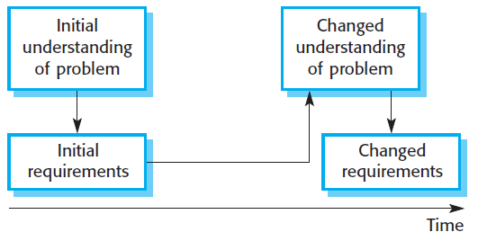
Requirements change
The requirements for large software systems are always changing.
Problems that cannot be completely defined

Slide 48
Summary
Requirements for a software system set out what the system should do and define constraints on its operation and implementation.
Functional requirements are statements of the services that the system must provide or are descriptions of how some computations must be carried out.
Non-functional requirements often constrain the system being developed and the development process being used. These might be product requirements, organizational requirements, or external requirements. They often relate to the emergent properties of the system and therefore apply to the system as a whole.
The requirements engineering process includes requirements elicitation, requirements specification, requirements validation, and requirements management.
Requirements elicitation is an iterative process that can be represented as a spiral of activities— requirements discovery, requirements classification and organization, requirements negotiation, and requirements documentation.

Slide 49
Summary
Requirements specification is the process of formally documenting the user and system requirements and creating a software requirements document.
The software requirements document is an agreed statement of the system requirements. It should be organized so that both system customers and software developers can use it.
Requirements validation is the process of checking the requirements for validity, consistency, completeness, realism, and verifiability.
Business, organizational, and technical changes inevitably lead to changes to the requirements for a software system. Requirements management is the process of managing and controlling these changes.

